Slide 1

CONTROL SYSTEM FOR SPECIAL NEEDS
A brain computer Interface approach
SUPERVISED BY:
PROF. Mohamed Taher El Sonni
Dr. Noureldin el Madany
Dr. Mohamed Hossam Zaky

Slide 2




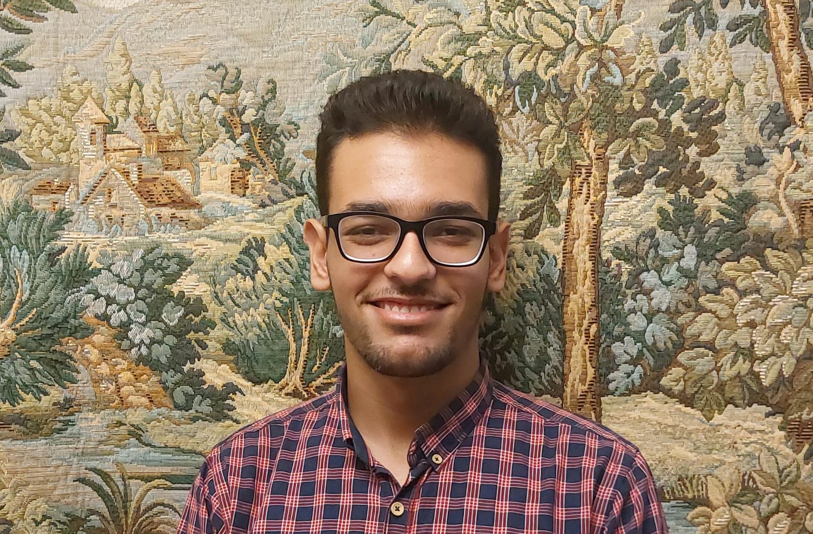

MADE BY
OMAR
EL LEISSY
MARIAM
REDA
MAZEN EL SEDFY
AHMED
TAREK
MOHAB HAYTHAM
MARWAN
MAHROUS

Slide 3
Table of contents
01
02
03
04
05
06
07
08
09
10
INTRODUCTION
BCI
EEG
ERP
APPLICATIONS DESIGN
OFFLINE ANALYSIS
ONLINE ANALYSIS
LIMITATIONS
CONCLUSION & FUTURE WORK
BUSINESS MODEL CANVAS

Slide 4
01
INTRODUCTION

Slide 5
EST.
Estimated number of people with motor impairment
1,300,000,000
Person have motor impairments
(WHO, 2023)

Slide 6
Introduction
Problem Statement
Over 1 billion people globally live with disabilities, experience motor impairments, this can severely limit their ability to use traditional computers. These individuals face significant barriers to digital access, excluding them from education, work, and social opportunities.
Solution Statement
We designed a brain–computer interface (BCI) system using EEG technology that enables individuals with motor disabilities to control a computer game entirely without physical contact. This solution empowers users to interact with digital environments, promoting inclusion, engagement, and accessibility.
Reference:
https://www.who.int/publications/i/item/9789241564182

Slide 7
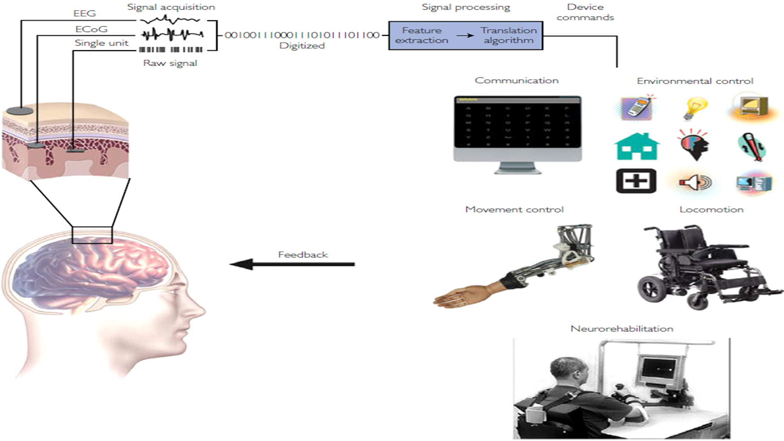
SOLUTION
According to the problem that handicapped people previously explained, We will develop a Brain Computer Interface, control system.
Brain Thoughts
Signals Acquisition
Preprocessing and Signal Enhancement
Feature Extraction/Selection
Machine Learning (Classification)
Application
BioFeedback

Slide 8
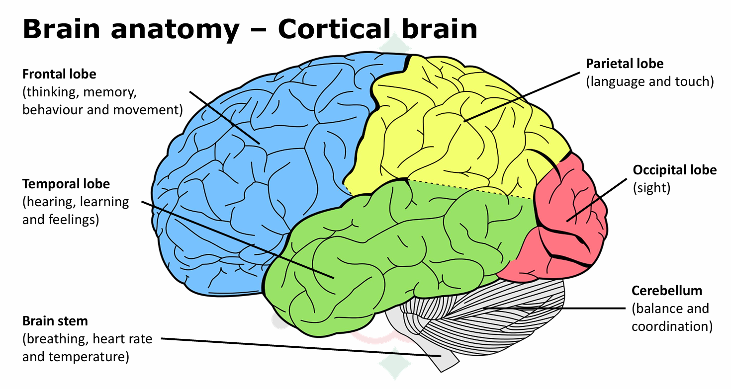
Brain Anatomy

Slide 9
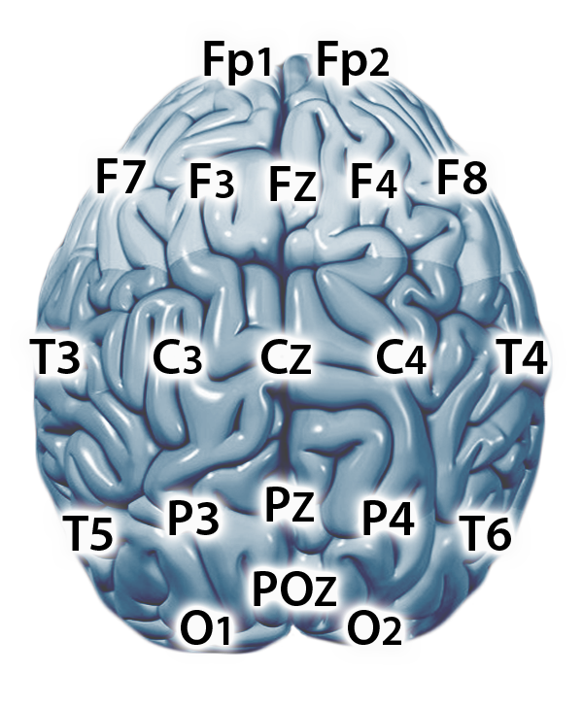
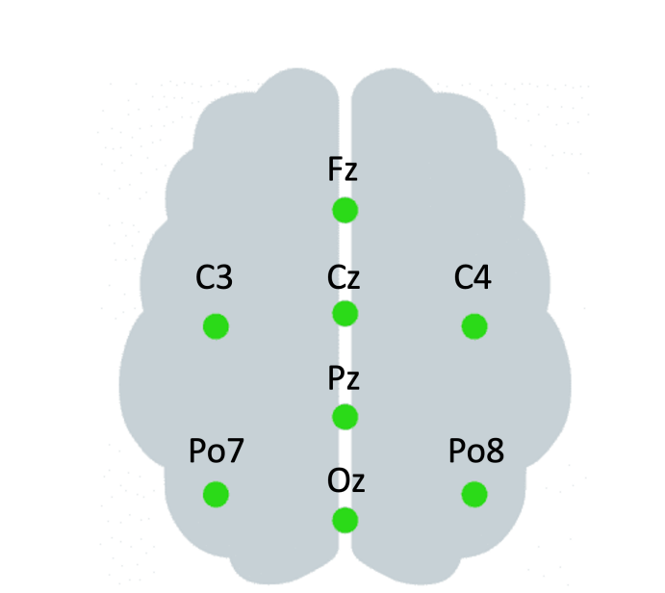
Figure 2: (A) Unicorn Hybrid Black system, (B) electrode positions for the P300 BCI interface

Slide 10
02
BCI
BRAIN COMPUTER INTERFACE

Slide 11
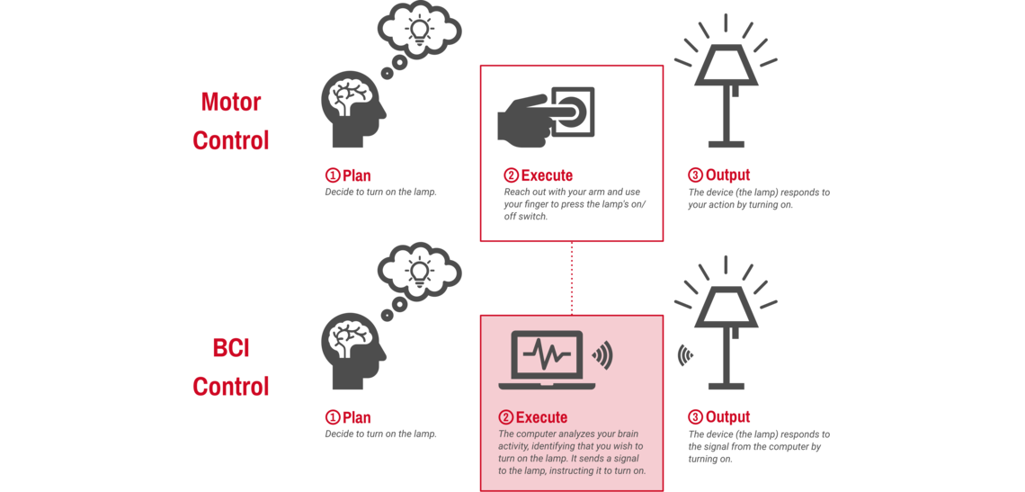
What is BCI?
BCI (brain computer interface) is a system that allows direct communication between the brain and an external device.
There are 2 types of BCI which are passive BCI and active BCI.

Slide 12
BCI APPROACHES
1
ACCORDING TO DEPENDABILITY
DEPENDANT VS INDEPENDENT
2
ACCORDING TO RECORDING
INVASIVE VS NONINVASIVE
3
ACCORDING TO MODE OF OPERATION
SYNCHRONOUS VS ASYNCHRONOUS

Slide 13
SAFETY & ETHICS
SAFETY
ETHICS
Skin and electrode hygiene
Duration of use
Check for contraindications
Proper fitting & adjustment
Environment
State Check
Informed consent
Privacy & data protection
User autonomy
Non-harm & well-being
Equity & inclusion

Slide 14
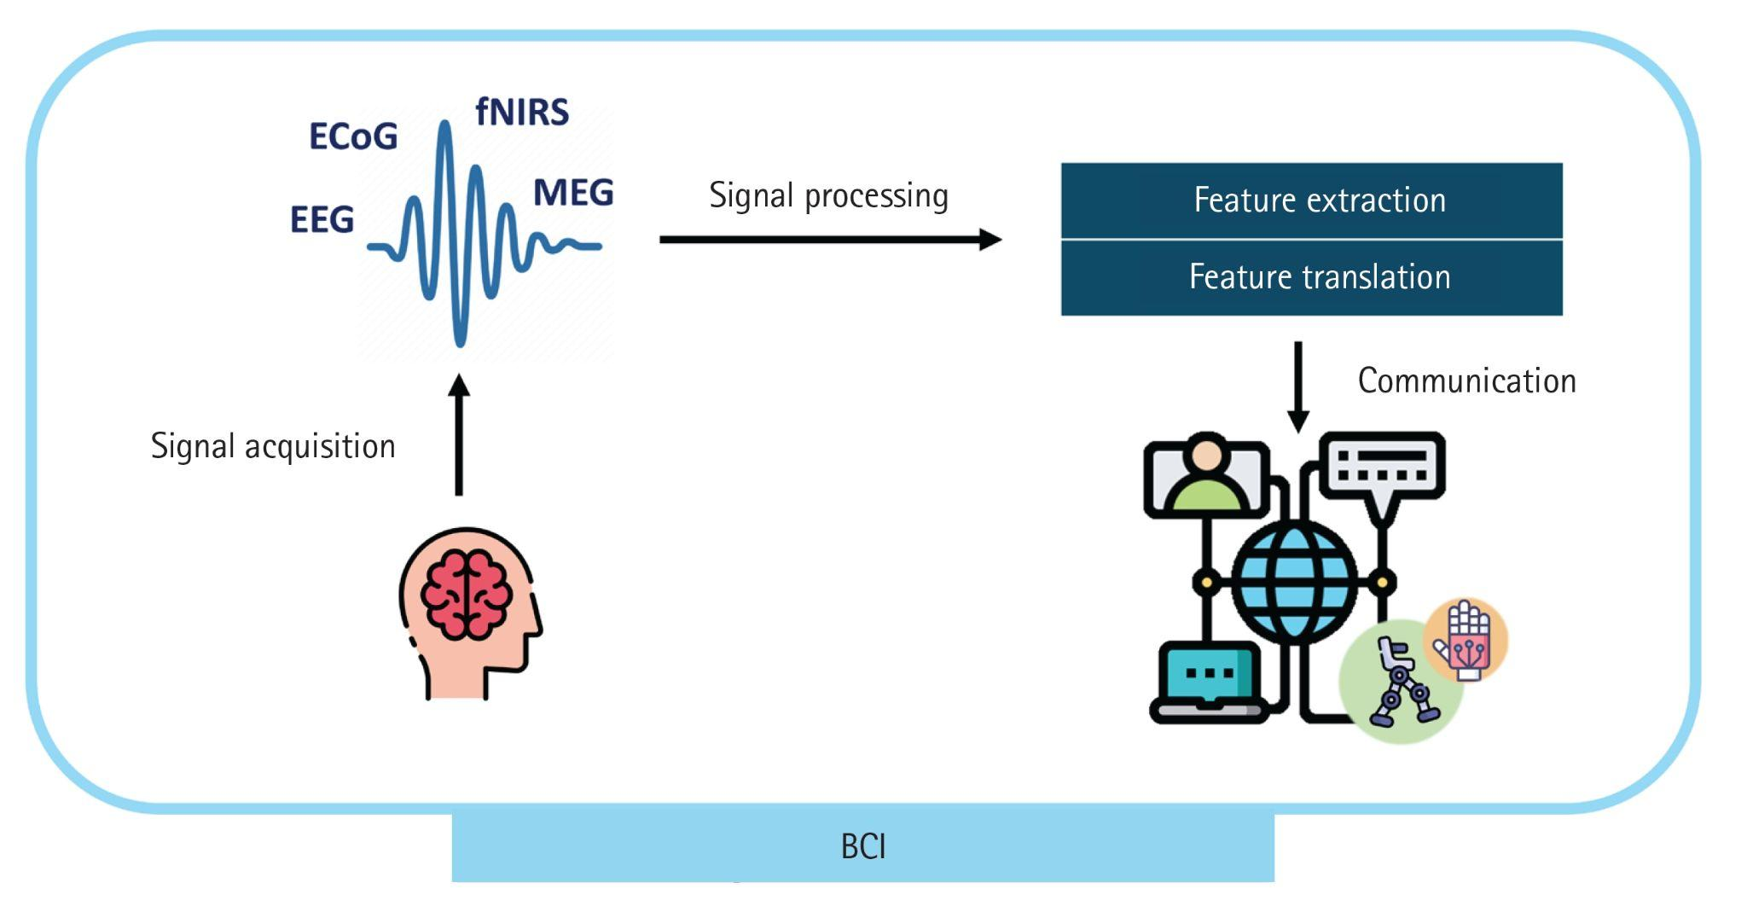
BRAIN RECORDING METHODS

Slide 15
03
EEG
ELECTROENCEPHALOGRAM

Slide 16
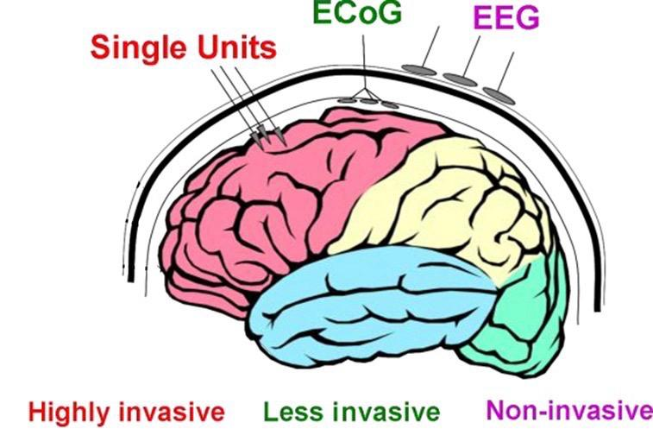
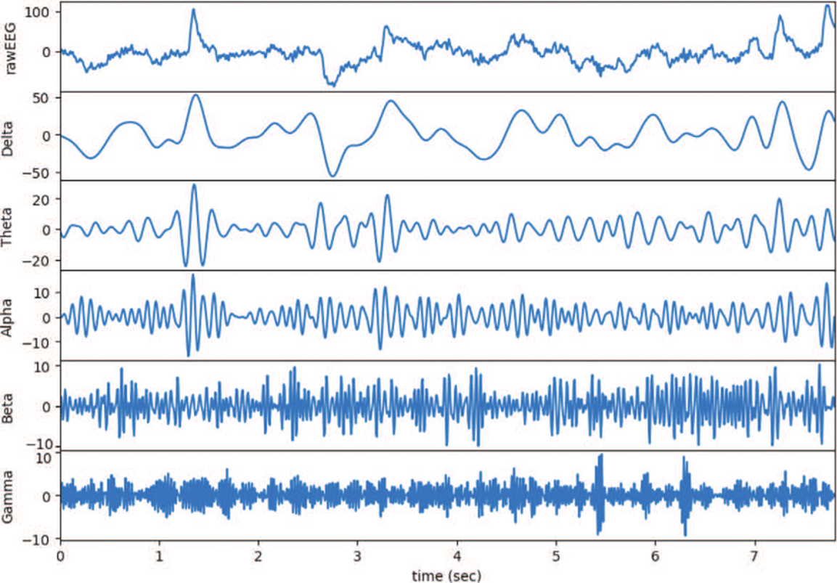
What is EEG (Electroencephalography)
non-invasive technique that captures brain signals from the scalp,reflecting different brain states.
signals are categorized into five types based on frequency ranges:
Delta (2 - 4 Hz).
Theta (4 - 8 Hz).
Alpha (8 - 14 Hz).
Beta (14 - 30 Hz).
Gamma (30 - 100+ Hz).

Slide 17
WHY EEG?
HIGH TEMPORAL RESOLUTION
EEG provides millisecond-level temporal resolution, superior to fMRI and optical methods, and comparable to MEG.
NON INVASIVE
EEG is non-invasive like MEG and fMRI, unlike ECoG which requires surgery.
04
01
03
AFFORDABLE
EEG is much more affordable than MEG and fMRI, and even cheaper than most optical imaging systems.
HIGH MOBILITY
EEG can be performed with portable, wearable systems, unlike bulky MEG, fMRI, or ECoG setups.
02

Slide 18
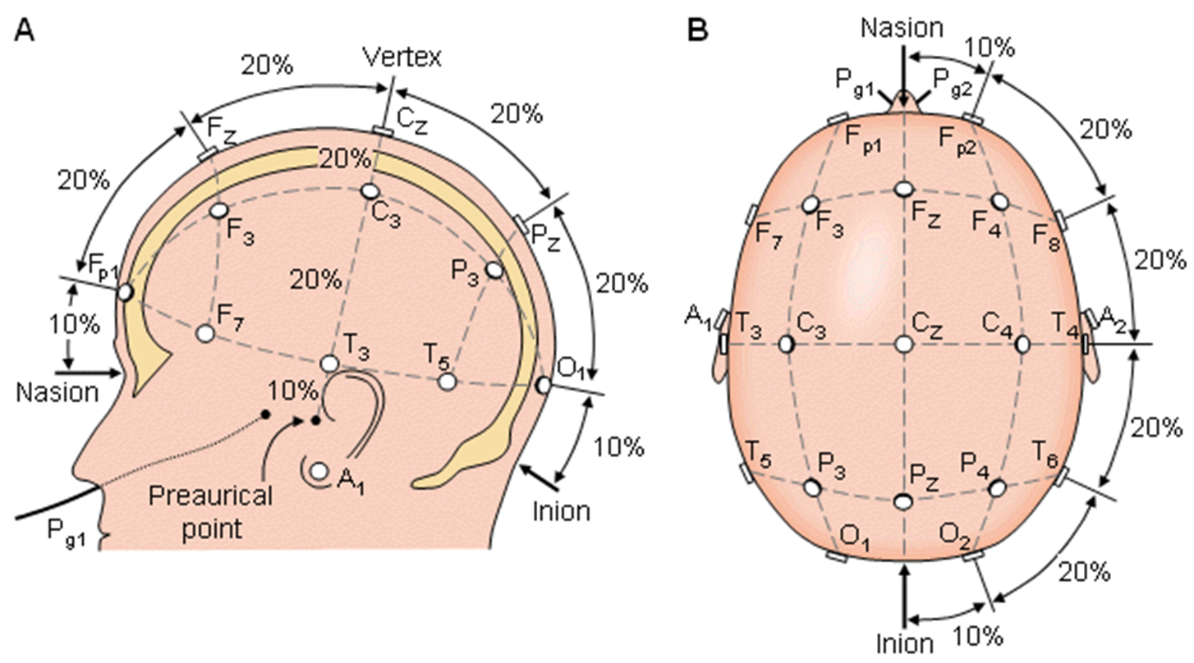
EEG Recording
EEG uses high-conductivity electrodes
(low impedance).
Unicorn Hybrid Black EEG headset has 8 electrodes
The 10-20 method separates electrodes
by 10-20% of the head's circumference.
Other systems have 32, 64, 128, 256, and 512 electrodes.

Slide 19
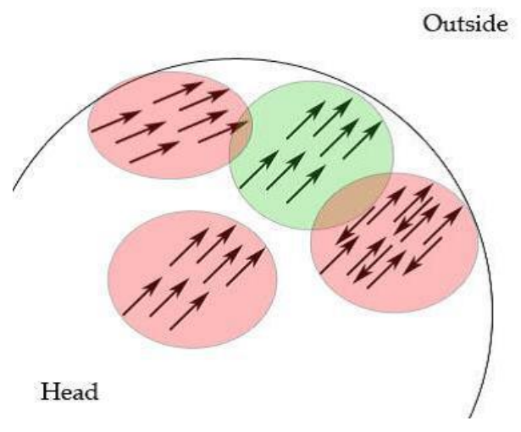
How does EEG measure changes in the brain?
Neuronal activation generates a localized current flow and scalp electrical field. The scalp electrodes' weak electrical signals must be amplified before being visualized.
Signal Transmission:
Neural activity passes through meninges, skull, and skin.
These "biological filters" spread and attenuate the signals.
Neural Signal Limitations:
Individual neuron signals are too small for EEG detection.
EEG detects collective neural activity, requiring synchronized neuronal firing.
Strengths and Weaknesses:
High temporal resolution (millisecond-level precision).
Low spatial precision (limited localization of activity).

Slide 20
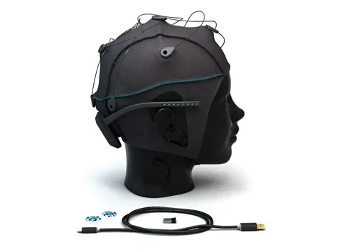
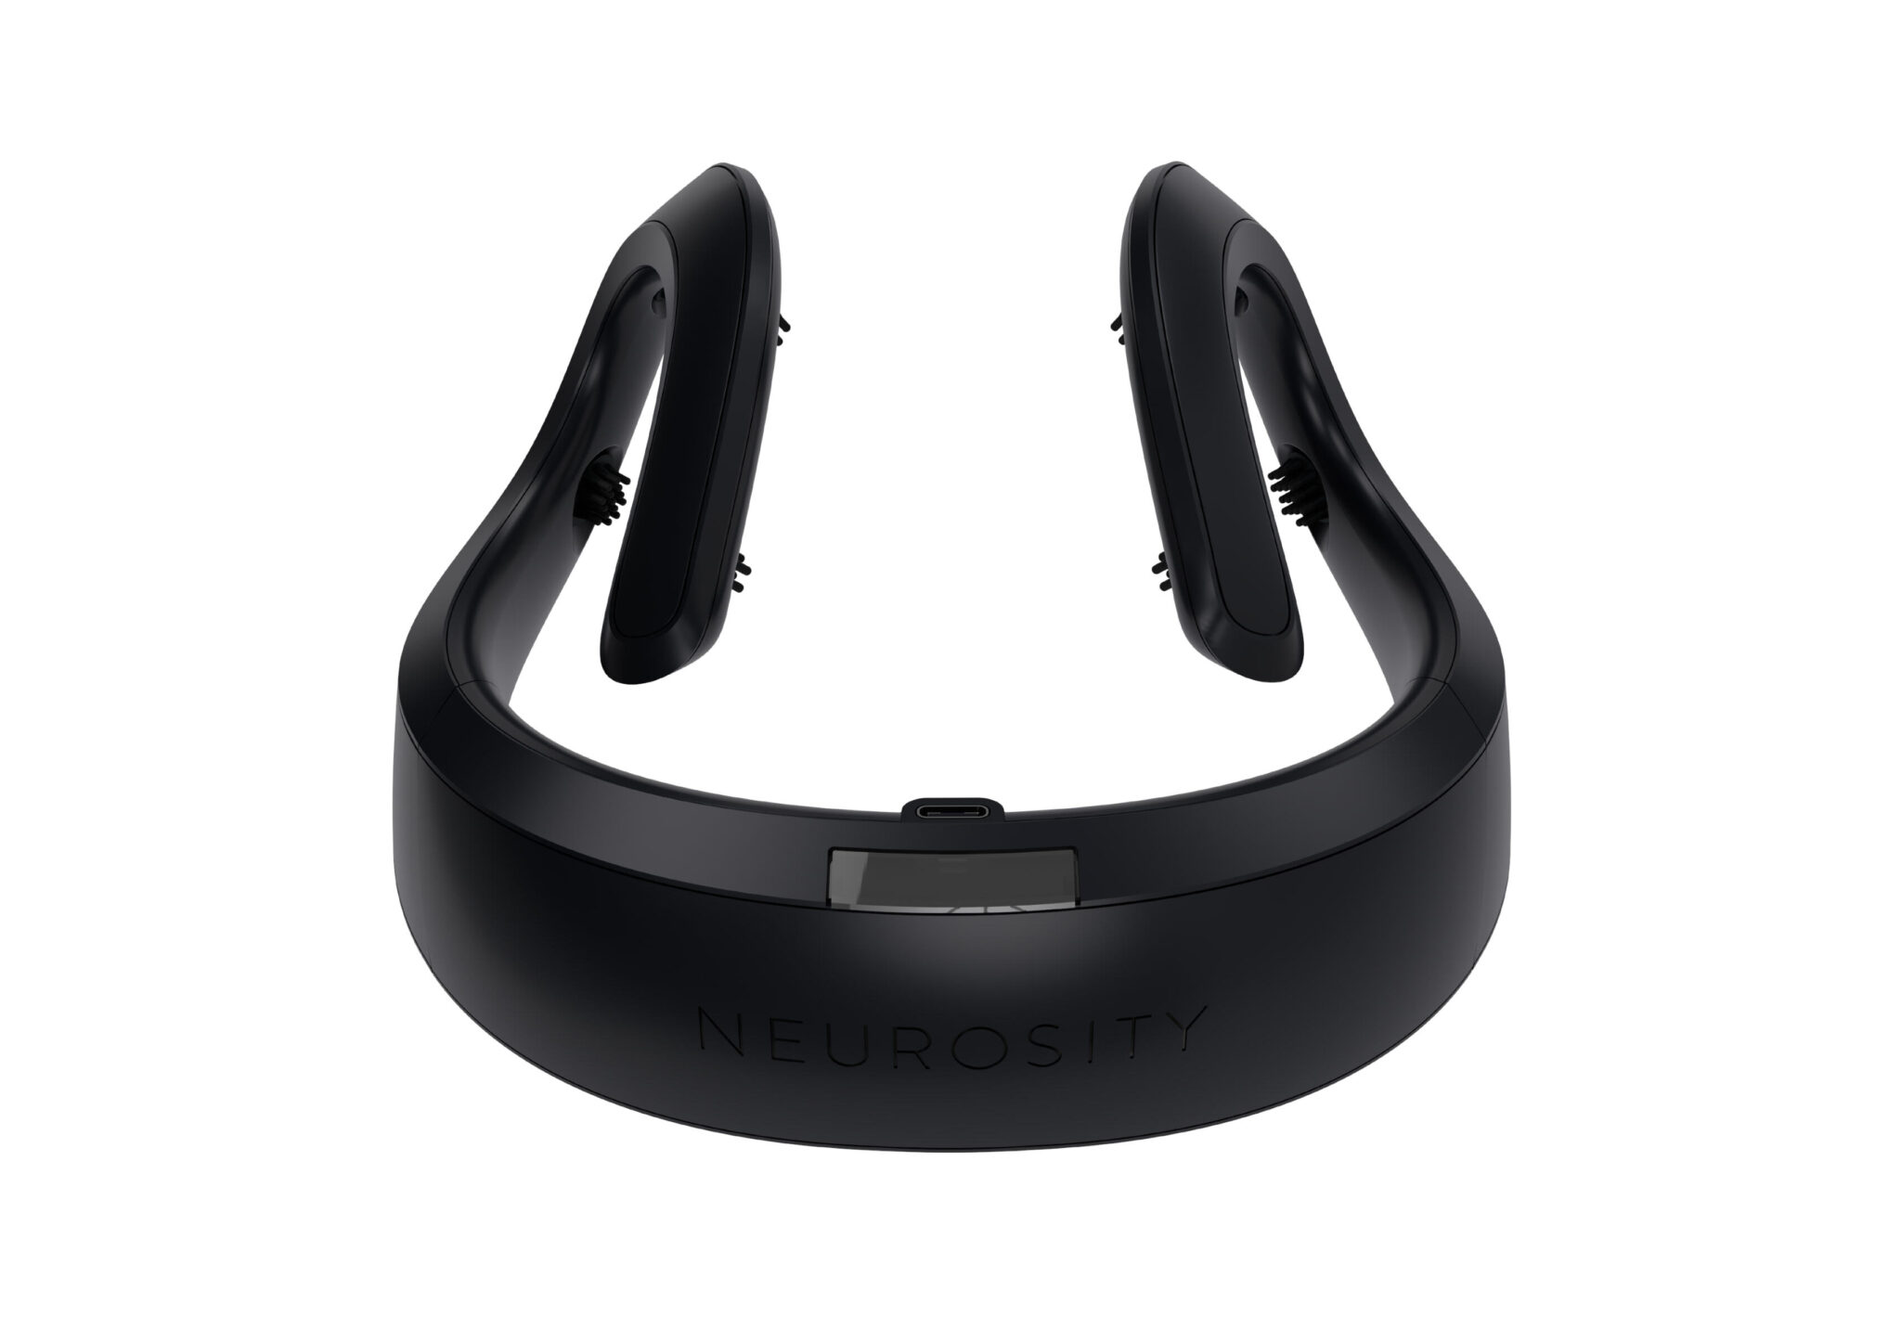
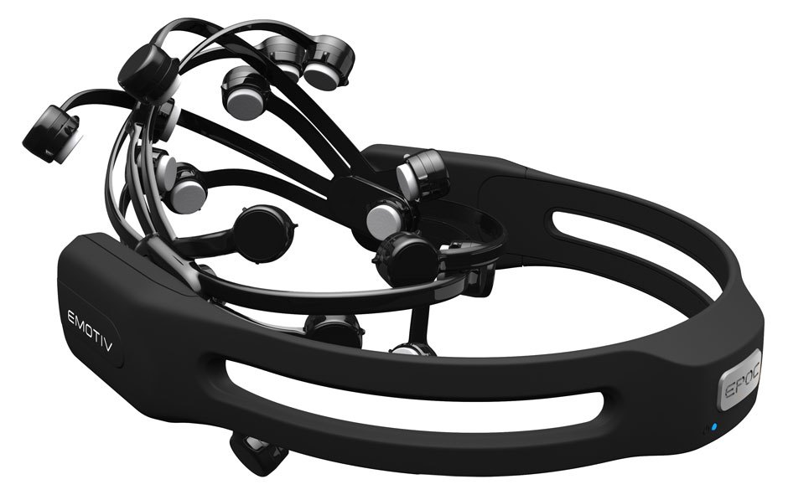
BCI DEVICES
Unicorn Hybrid Black
Neurosity Crown
Emotiv Epoc+
Unicorn Hybrid Black is a Brain-Computer Interface (BCI) headset developed by g.tec, designed for non-invasive EEG data acquisition. It is commonly used in research and practical applications due to its advanced features and user-friendly design.
Neurosity Crown is a cutting-edge, non-invasive brain-computer interface (BCI) device designed to monitor and enhance mental performance through real-time EEG analysis. Developed by Neurosity, the device is tailored for productivity, mindfulness, and wellness applications, offering insights into cognitive states.
Emotiv Epoc+ is a portable and non-invasive EEG headset developed by Emotiv, designed for real-time brainwave monitoring and applications in neuroscience, research, and consumer-focused use cases.

Slide 21
Types of Neural Stimuli
EEG SIGNALS
Evoked Potential
Spontaneous
Occur without external stimulation such as motor imagery, such as ERP.
Electrical signals generated by the brain in response to external stimuli.

Slide 22
04
ERP
Event-Related Potential

Slide 23
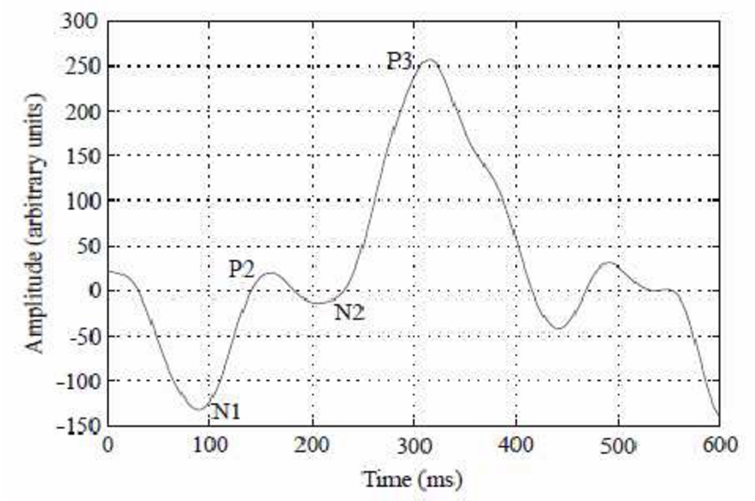
What is ERP(Event-Related Potential)
ERPs are brain activity changes triggered by events, measured with EEG.
Applications: Communication tools, device control, and gaming.
Benefits: Enable non-invasive, real-time BCI interactions.
Challenges: Signal noise and user training requirements.

Slide 24
ERP(Event-Related Potential) Components
Face and Object Processing Component
Motor and Error Components
Attention-Related Components
Sensory Components
Cognitive Components
P50 / N100 / P200
P300 / N400 / P600
Bereitschaftspotential (BP)
Error-Related Negativity (ERN)
Mismatch Negativity (MMN)
Contingent Negative Variation (CNV))
N170
1
2
3
4
5

Slide 25
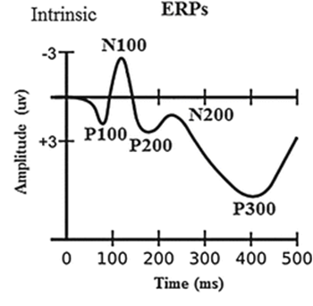
Why ERP NOT SSEP (Somatosensory Evoked Potentials)
Timing and Precision (Time-locked)
Cognitive Feedback (Trigger)
Player Comfort
Flexibility

Slide 26
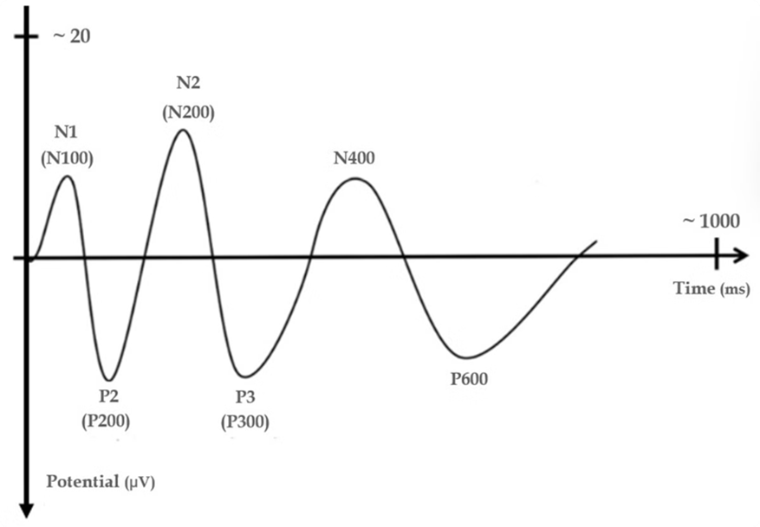
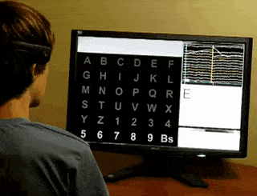
What is P300 AND WHY
The *P300* is a positive peak in EEG occurring about 300ms after a stimulus, associated with attention, memory, and decision-making.
Reliable Signal
Fast Response Time
Non-Invasive
Low Cognitive Load

Slide 27
05
APPLICATIONS DESIGN

Slide 28
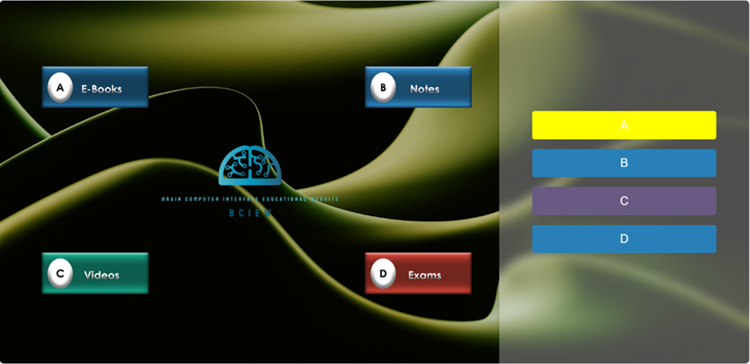
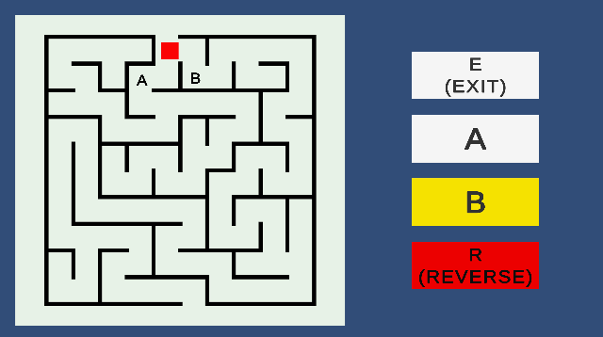
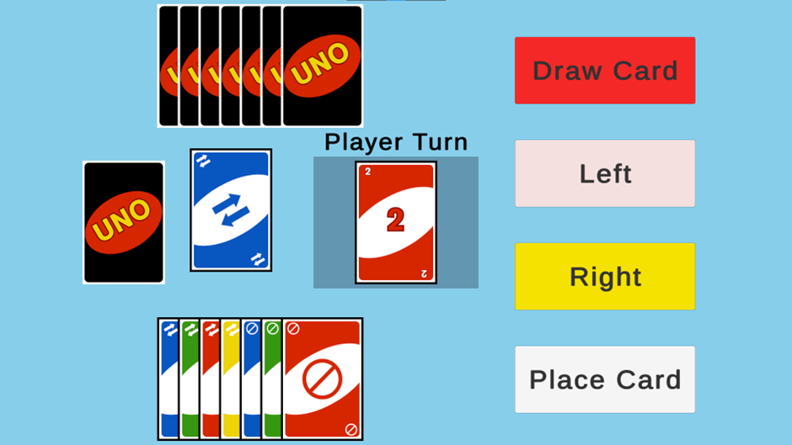
Applications Design
EDUCATIONAL WEBSITE
MAZE GAME
UNO GAME

Slide 29
APPLICATIONS LAYOUT AND OFFLINE FLASHING
LAYOUT
OFFLINE FLASHING
1/3 OF THE SCREEN BUTTONS
2/3 OF THE SCREEN IS THE TASK
Flash red on 9 random buttons nine times non-target
In the 10th flash it intersects with the yellow target button
It waits for this loop to happen 3 times
On the 3rd time it sends button data to the interface
Moves to the next target button and redo the previous steps until task is over

Slide 30

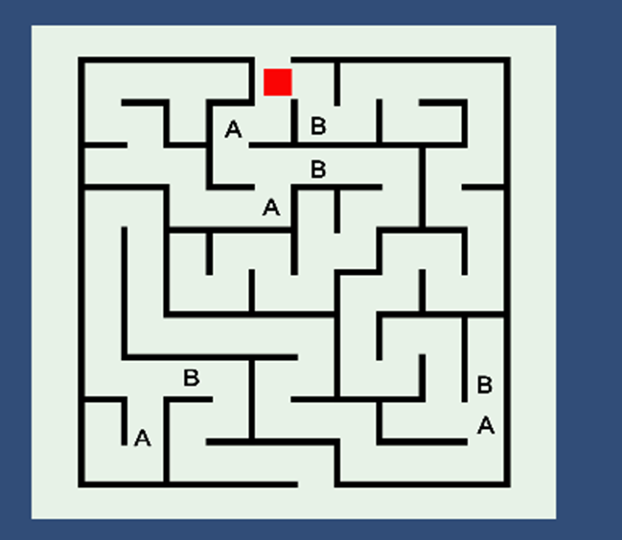
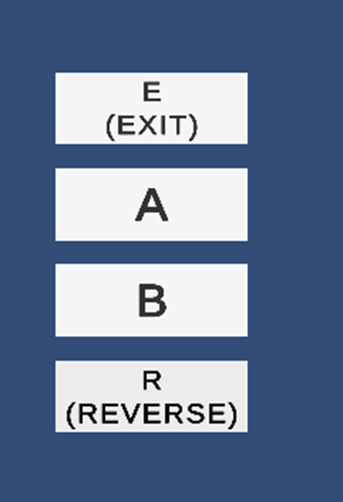
OFFLINE INTERFACE

Slide 31
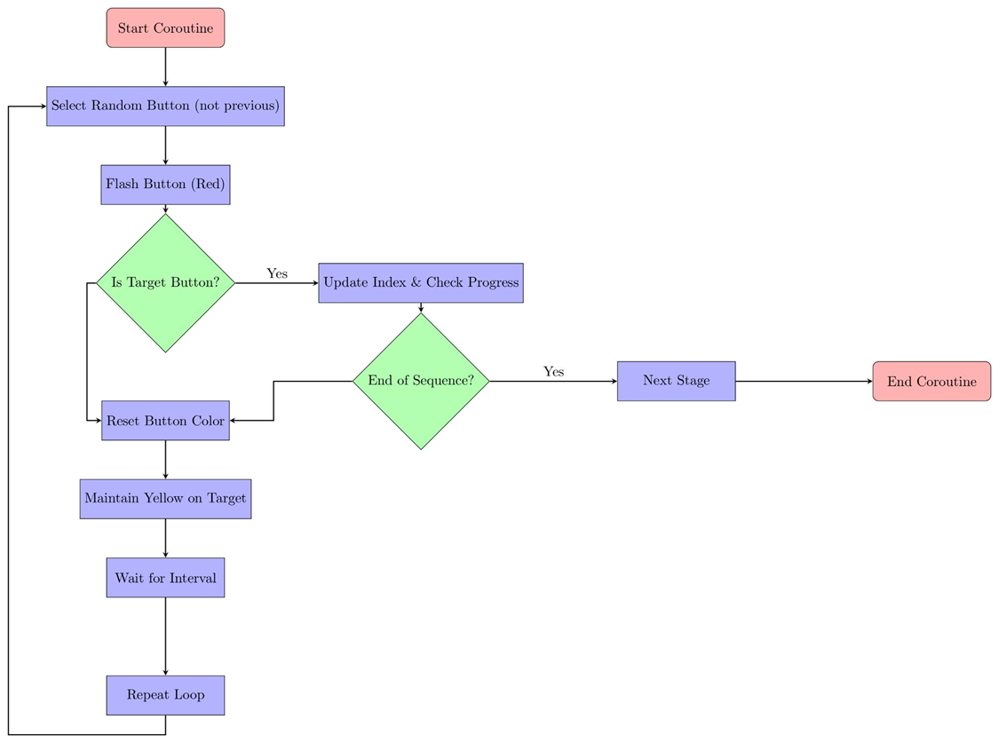
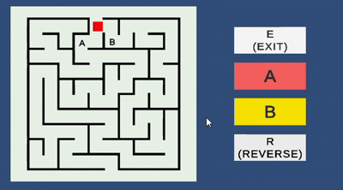
Button Flashing

Slide 32
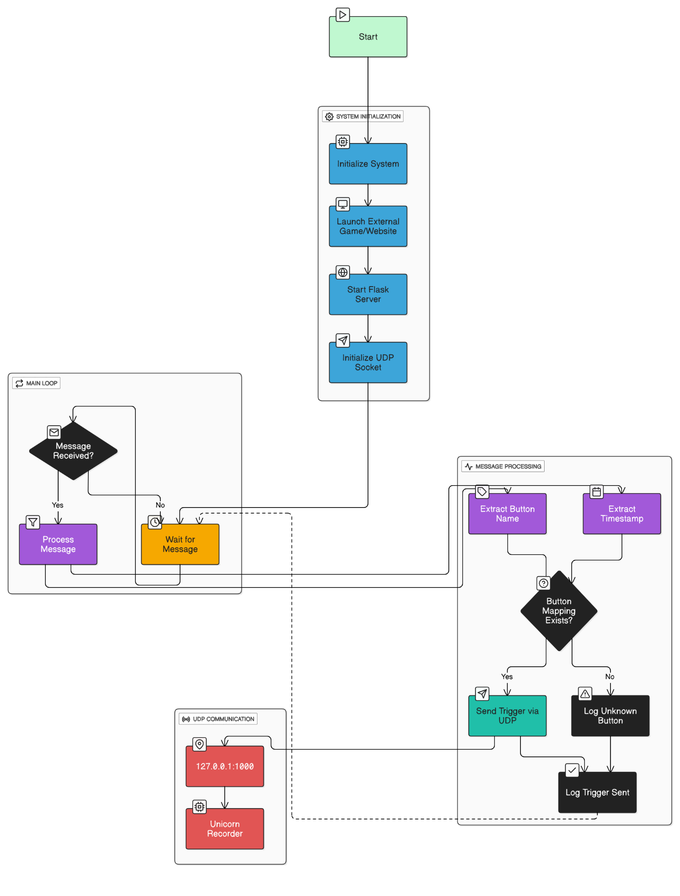
OFFLINE COMMUNICATION

Slide 33
MAZE GAME TASK
Start: Path A or B.
Choice: Visual effect highlights the selected path.
Move: Block advances to the chosen endpoint.
Repeat: Two new paths Navigate: Process continues
Win: Reward animation/message for winning endpoints.
Lose: Failure animation/message for losing endpoints.

Slide 34
UNO GAME TASK Offline Analysis
Fixed setup: 7 cards per player + 1 face-up card (controlled scenario).
Animations: Smooth card movements + button highlights.
Breaks: "Next scenario" button between rounds for client relaxation.
Goal: Clean data collection on decision patterns.

Slide 35
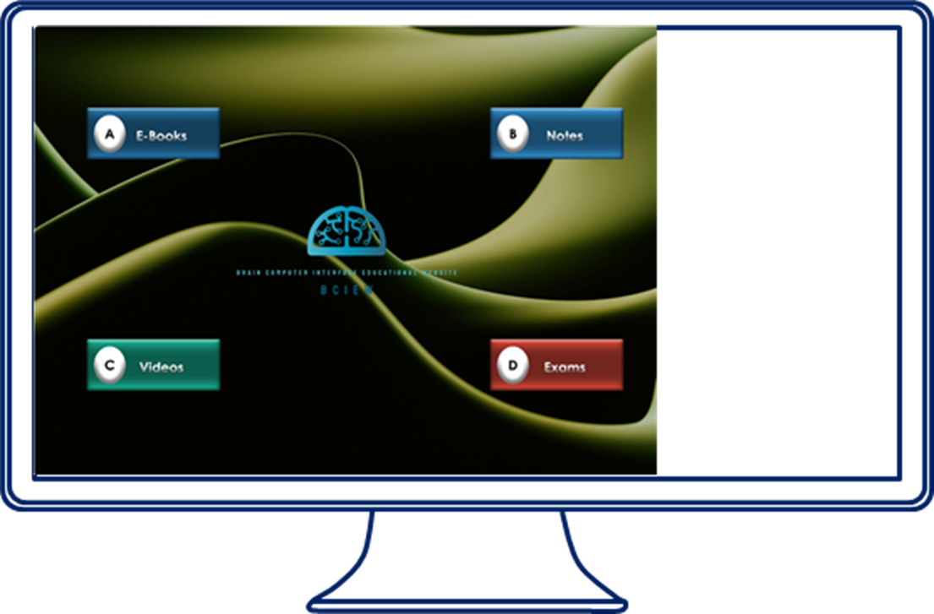

EDUCATIONAL WEBSITE TASK
Accessible learning space for individuals with special needs.
Offers a curated selection of subject categories where users can explore various of information depending on the subject desired.
CATEGORIES
Books
Videos
Notes
Exams

Slide 36
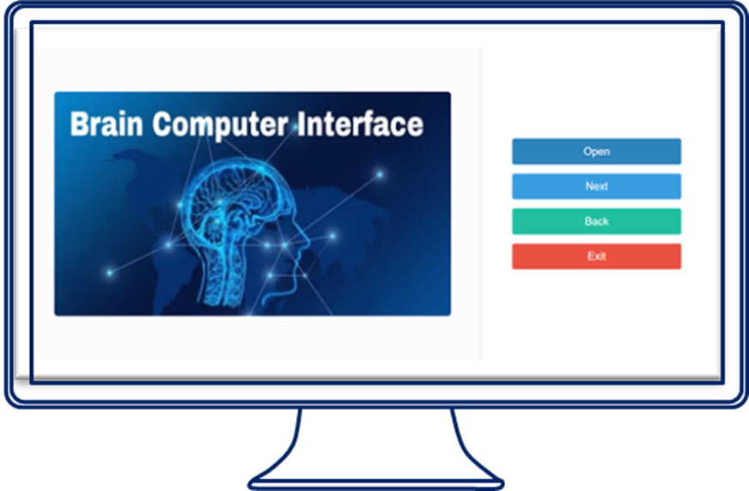


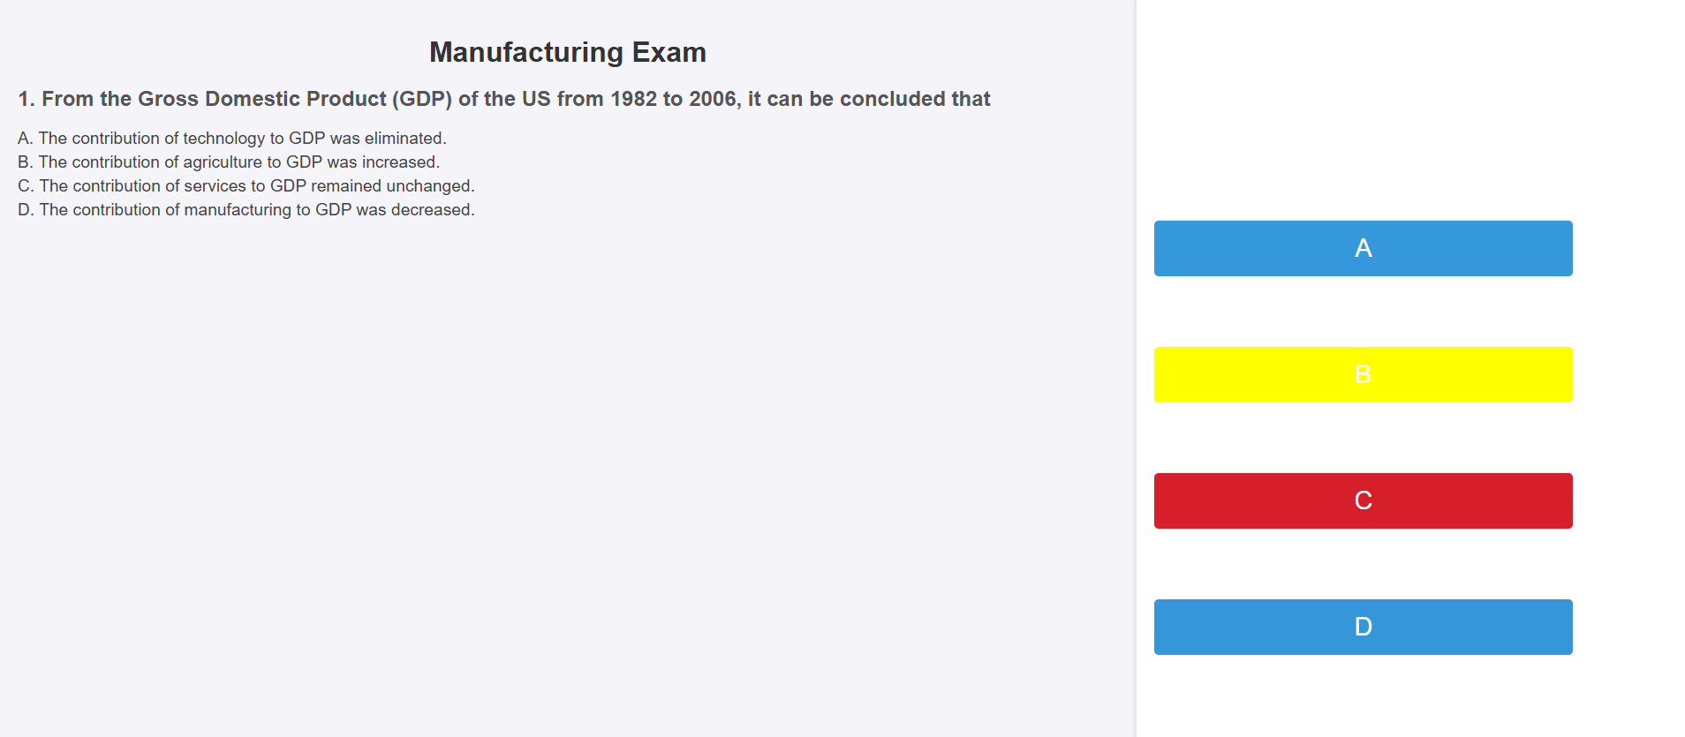
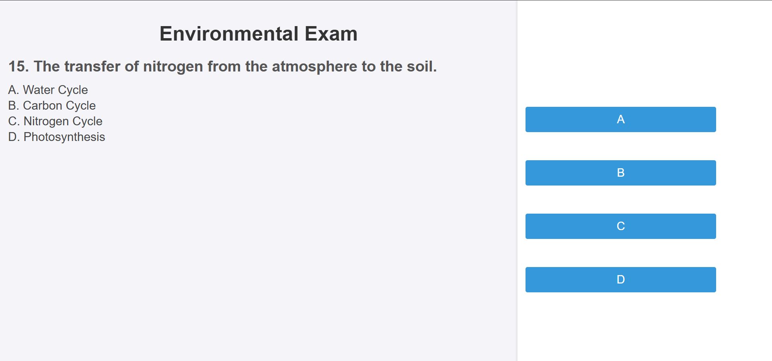
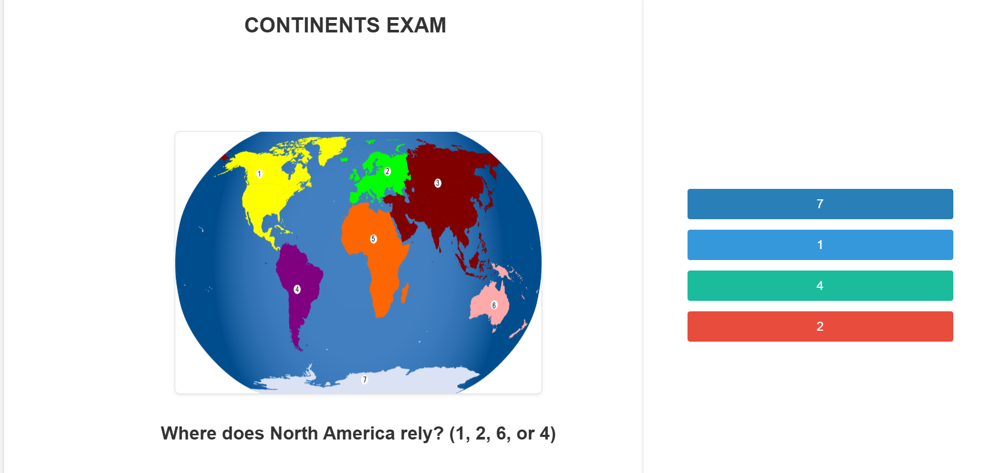
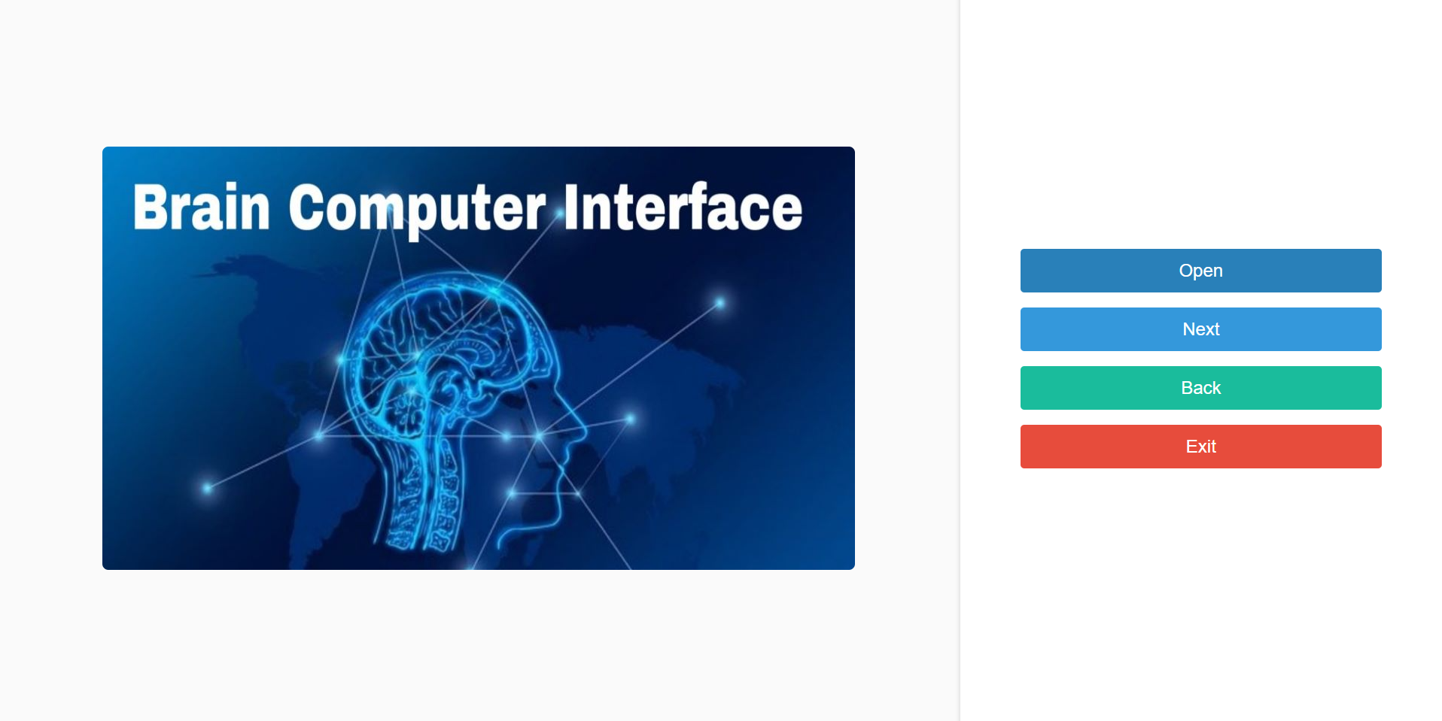
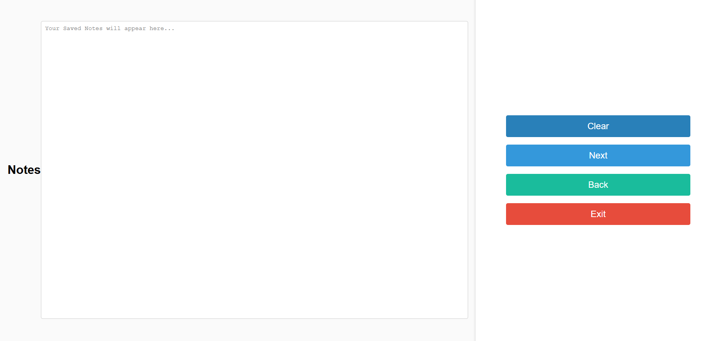
EXAMS & NOTES OPTION
EXAMS UI
NOTES CATEGORIES UI
NOTES UI

Slide 37
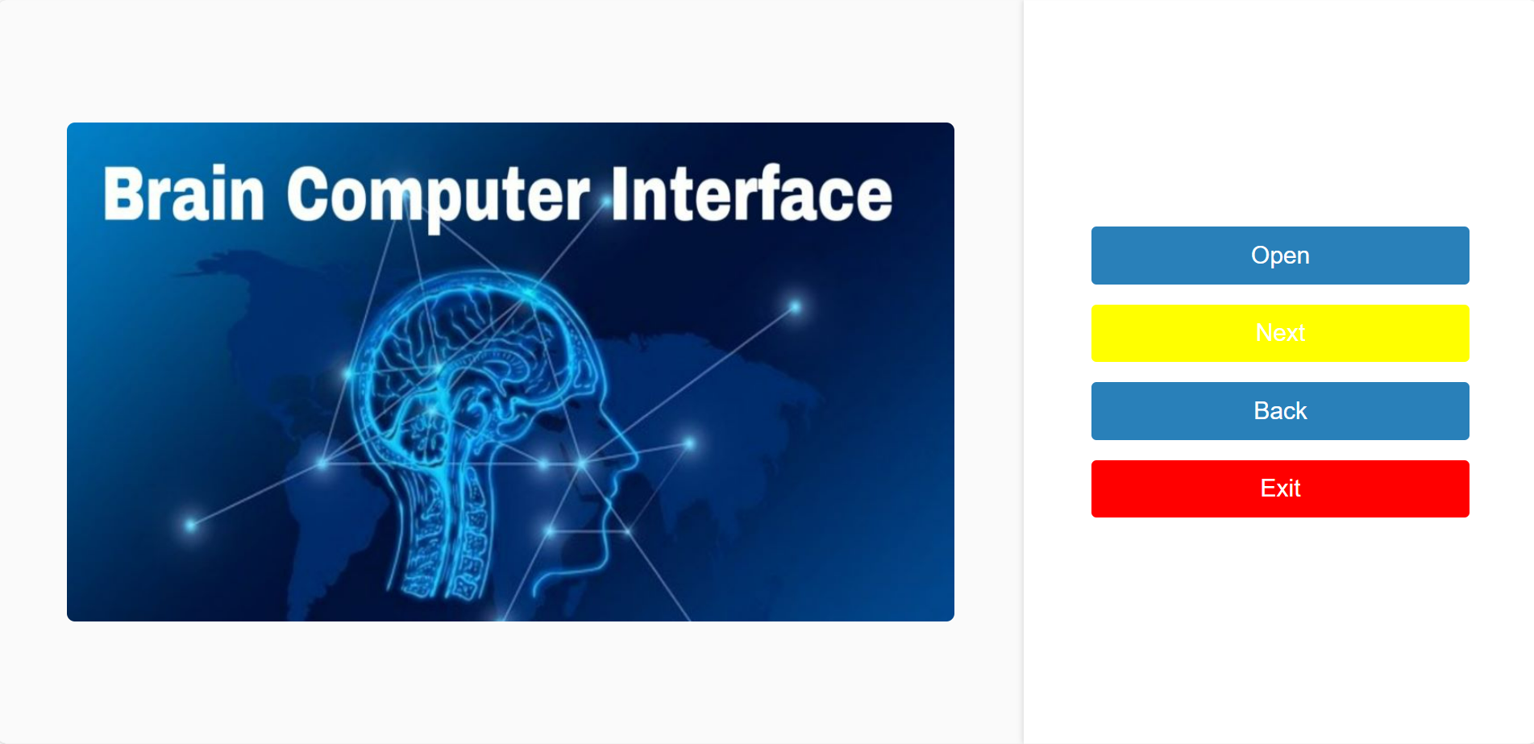
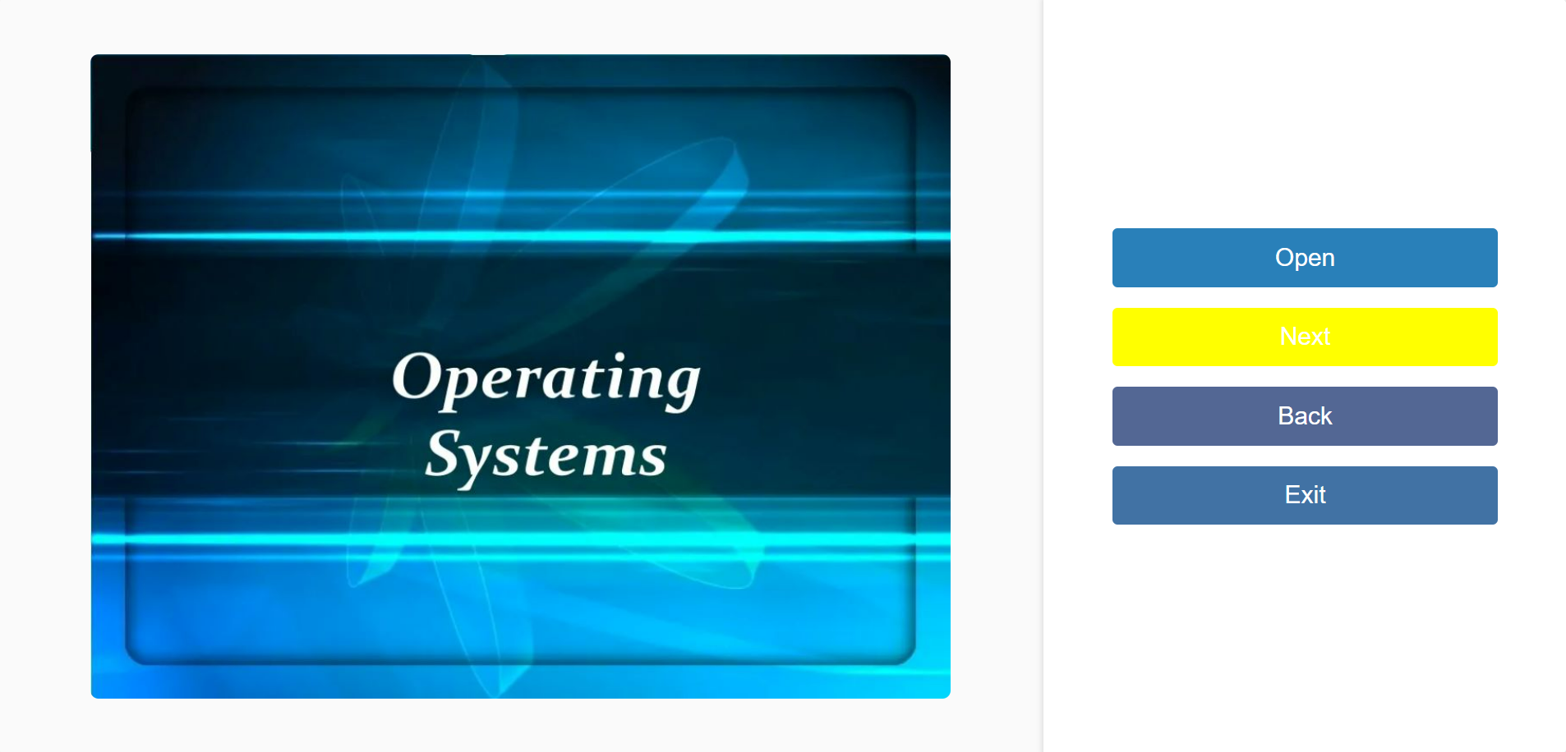

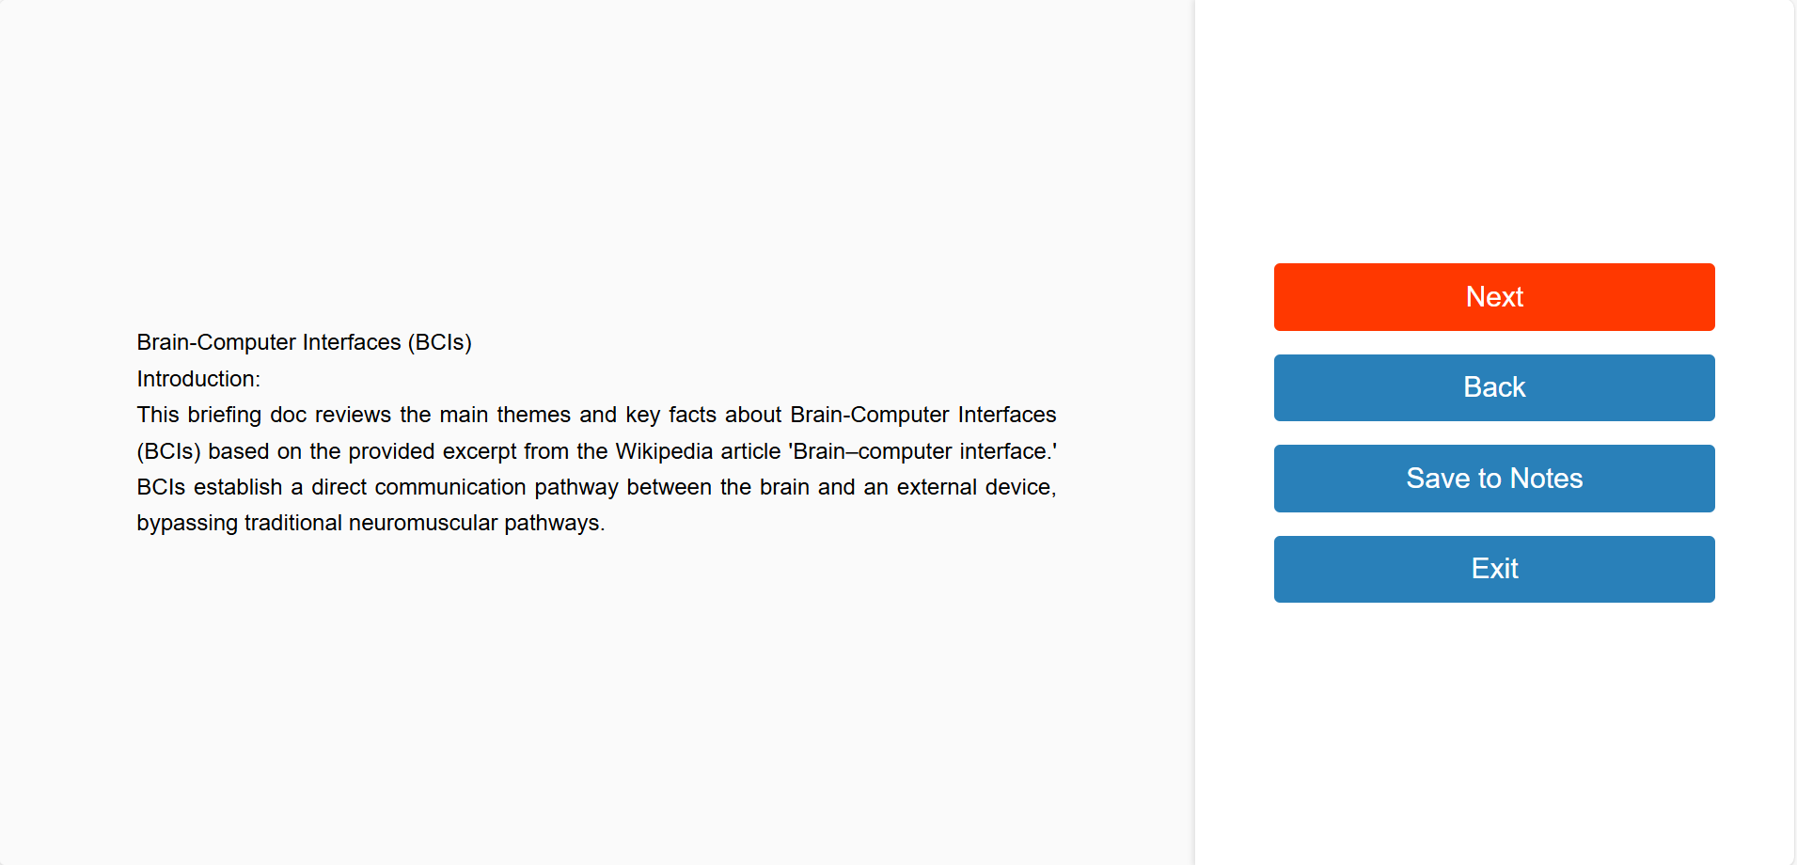
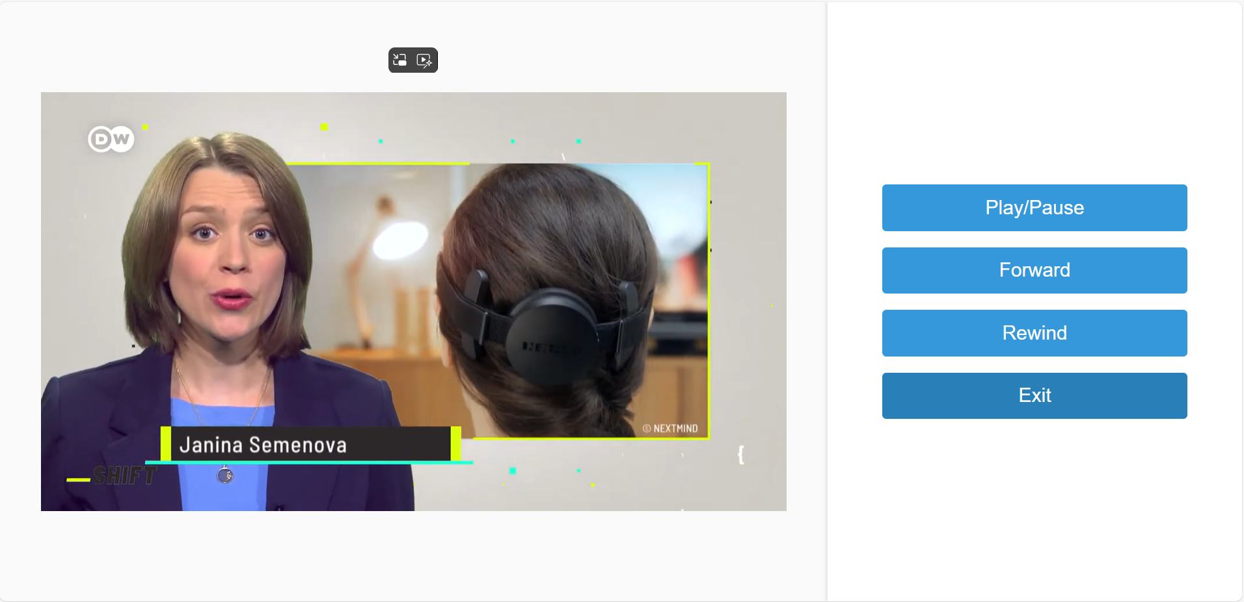
BOOKS & VIDEOS OPTION
Subjects UI
Book UI
Video UI

Slide 38
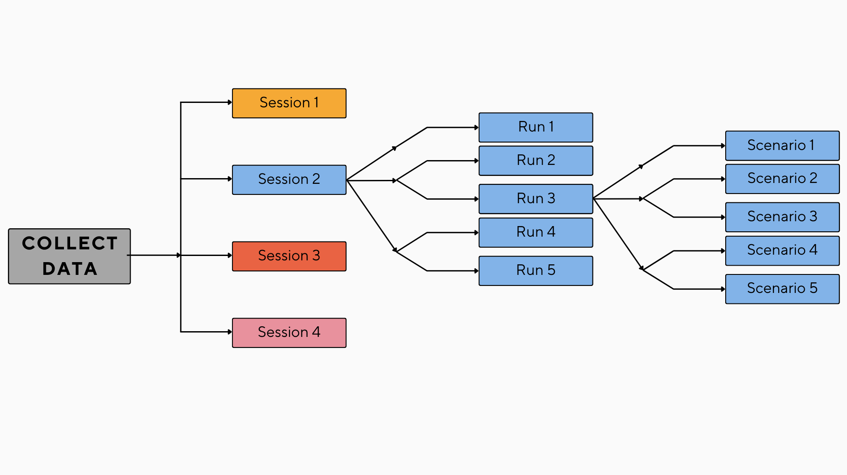
DATA STRUCTURE
Data collection from: UNO Game for more balanced & precise data.
Data collection of our dataset through our well thought-out designed scenarios.
A total of 1340 Trials
(134 Trials Per Run).

Slide 39
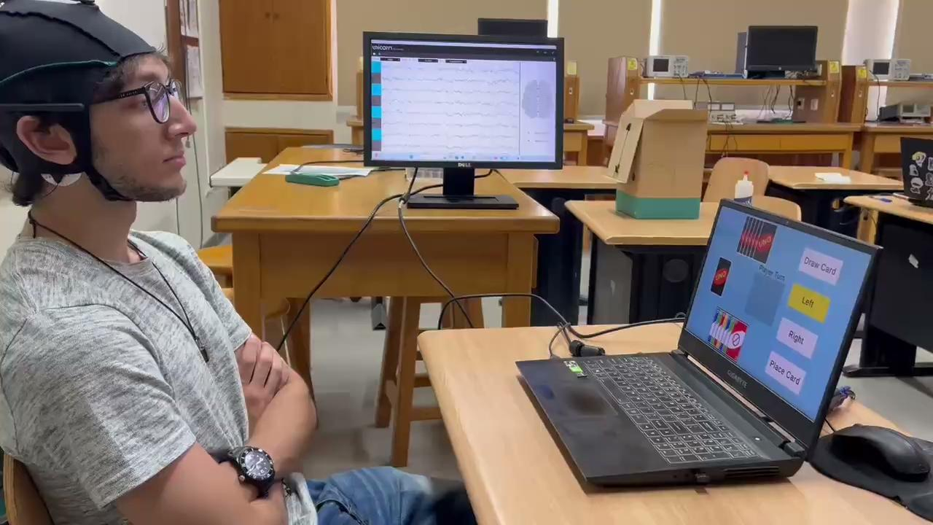
DATA COLLECTION SESSION

Slide 40
06
OFFLINE ANALYSIS

Slide 41
EST. 15-30%
Of people are unable to control BCI accurately (BCI illiteracy)
(IEEE, 2022)

Slide 42
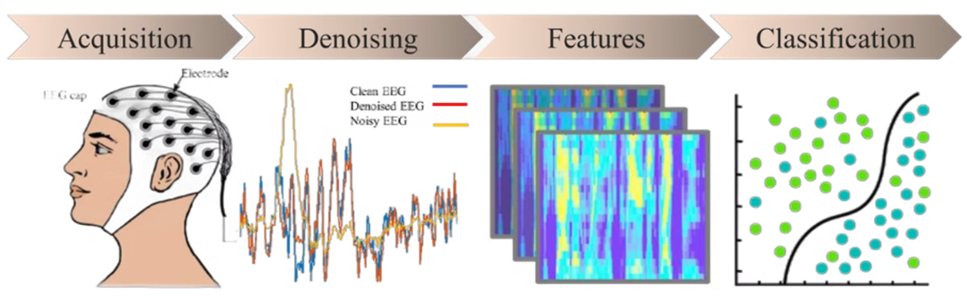
EEG Analysis

Slide 43
Artifacts(noises)
01
Head or cable movements
External Movement
02
Instrumentation Noise
Electrode impedance issues
03
Power line interference (50/60 Hz)
Electromagnetic interference (EMI)
Environmental Noise
04
Slow voltage drifts in the signal over time Caused by poor grounding or sweat accumulation
Baseline Noise
05
Eye movements and blinks (EOG)
Muscle activity (EMG)
Heartbeat (ECG)
Sweat and skin potentials
Physiological Noise

Slide 44

Preprocessing
open source software
Preprocessing(Denoising)
Import Raw Data
Downsample (if necessary)
Bandpass Filter (0.1–30 Hz) Notch Filter (50/60 Hz)
Electrode Interpolation (fix noisy channels)
Epoching (baseline correction)
Artifact Removal (ICA for blinks and muscle noise)
Clean data

Slide 45
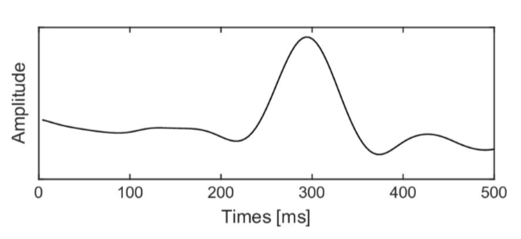
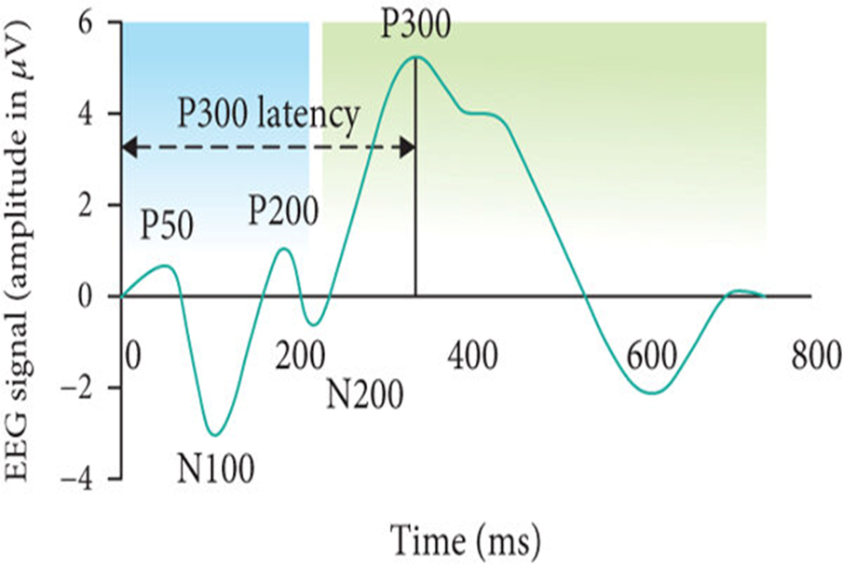
FEATURE EXTRACTION
A feature based on a signal amplitude is the simplest temporal information, P300 is an example of a temporal feature.
Key Features: peak amplitude,latency and AUC (area under the curve)
Statistical features: mean and median
ACCORDING TO LITERATURE:
The mean value, standard deviation, and p-value of P300 latency and amplitude, respectively,are the statistical analysis through test. (Feb 2017, PubMed).

Slide 46
Why time domain not frequency?
Time Domain
Frequency Domain
Easier interpretation related to specific stimuli
Suitable for analyzing transient responses (e.g., P300)
Enhanced temporal resolution
Real-time data on cognitive events
More complex and requires additional interpretation
May miss transient events
Can obscure temporal relationships
Computationally intensive

Slide 47
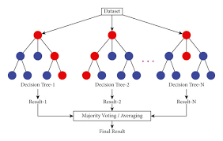
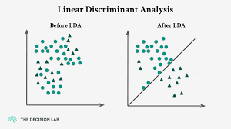
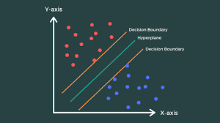
MACHINE LEARNING MODELS
LINEAR DISCRIMINANT ANALYSIS (LDA)
SUPPORT VECTOR
MACHINE (SVM)
supervised learning algorithm.
finds the optimal hyperplane.
separate different classes by maximizing the margin between the closest data points.
supervised classification method.
projects data into a lower-dimensional.
maximize class separation by finding linear decision boundaries.
RANDOM FOREST(RF)
ensemble learning method.
builds multiple decision trees and combines their outputs (via voting or averaging.)
improve accuracy and reduce overfitting.

Slide 48
AI MODEL PHASES
Phase 1
Phase 2
Phase 3
Who will collect data ?
What game will we use to collect data?
What format will we put data in ( CSV, JSON, XML, and binary formats ) ?
File Hierarchy format ?
What AI model will we use ( Random Forest , SVM , LDA )
Classes were unbalanced and Data wasn’t enough.
What channels to focus on while collecting data
What will we do with data , use it raw or do augmentation on it.
How will game send the triggers to unicorn hybrid Recorder ?
Client focus fades away during session .
How will we connect all applications together ?
Why game is unable to receive triggers from the server ?
Why the 1st button (Aka Draw Card ) was undetected ?

Slide 49
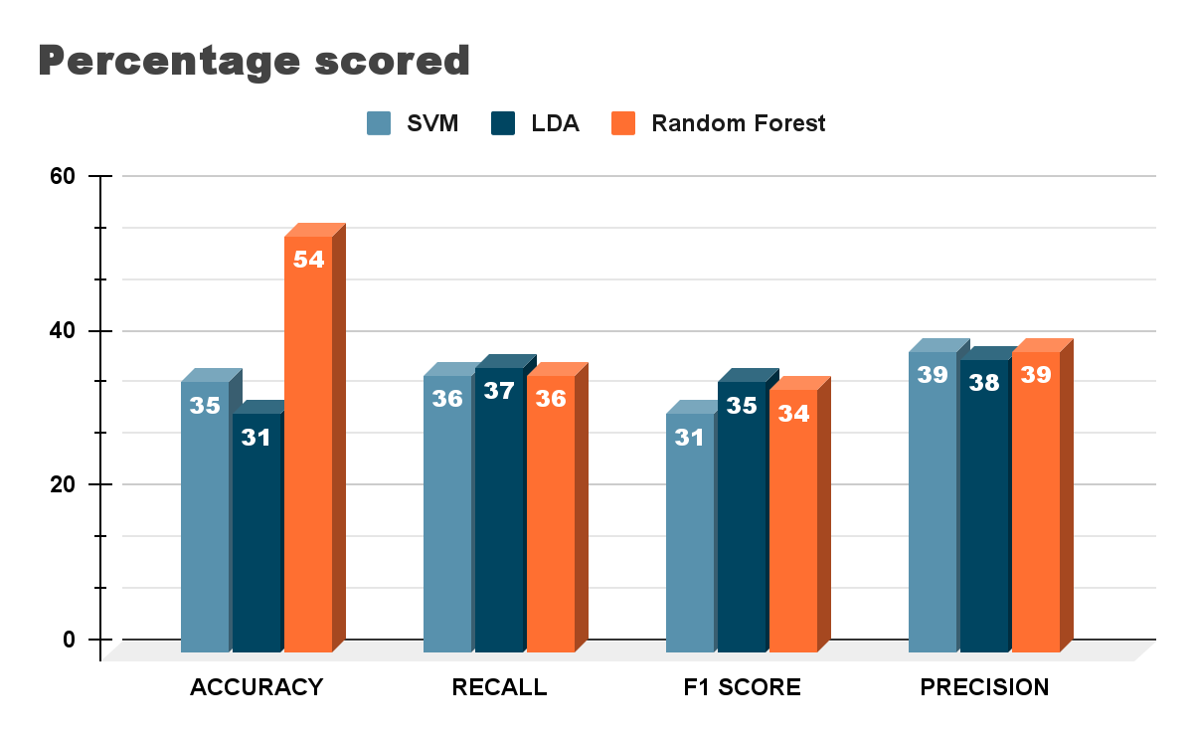
MACHINE LEARNING MODEL PERFORMANCE

Slide 50
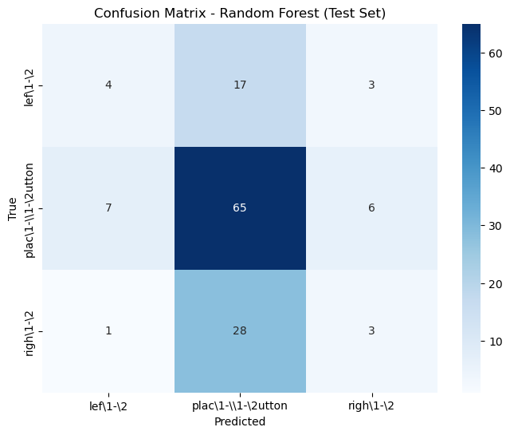
MACHINE LEARNING MODEL CONFUSION MATRIX

Slide 51
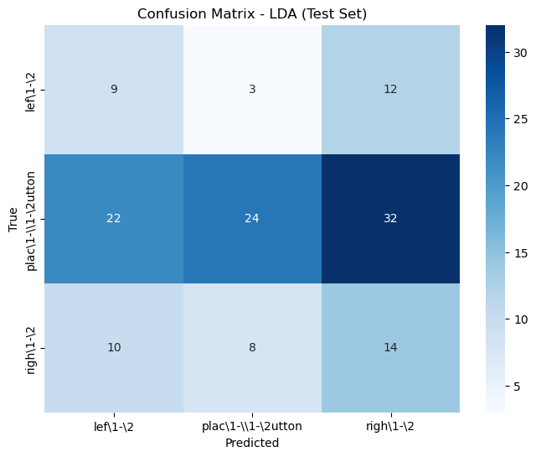
MACHINE LEARNING MODEL CONFUSION MATRIX

Slide 52
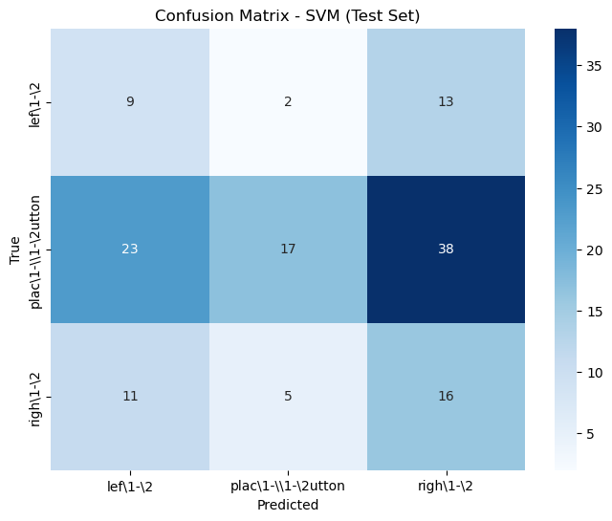
MACHINE LEARNING MODEL CONFUSION MATRIX

Slide 53
05
ONLINE ANALYSIS

Slide 54
UNO GAME TASK ONLINE ANALYSIS
Game starts with each player holding 7 cards and one card is placed faced up on the ground
The player has to decide one button from 4 buttons that has Visual effect highlights ( Draw Card , Left , Right , Place Card)
Smooth animation for cards movement
Player/Computer repeats process of decision making each one in his alternative turn
If player/computer wins a reward animation/message for winning round.
If player/computer loses a failure animation/message for losing round.

Slide 55
AI MODEL PREDICTION
To achieve real-time EEG signal acquisition and classification, the Python pylsl library (Lab Streaming Layer) was used to stream data directly from the EEG headset to the AI model.
The system architecture included the following stages:
Live signal acquisition through StreamInlet using pylsl.
Online preprocessing using a Butterworth band-pass filter (0.1–30 Hz).
Real-time feature extraction, focusing on peak amplitude , area under the curve (AUC) and peak latency within a defined time window.
Classification using a pre-trained RF model.
Transmission of predicted class labels to a Flask-SocketIO server for UI response and logging.

Slide 56
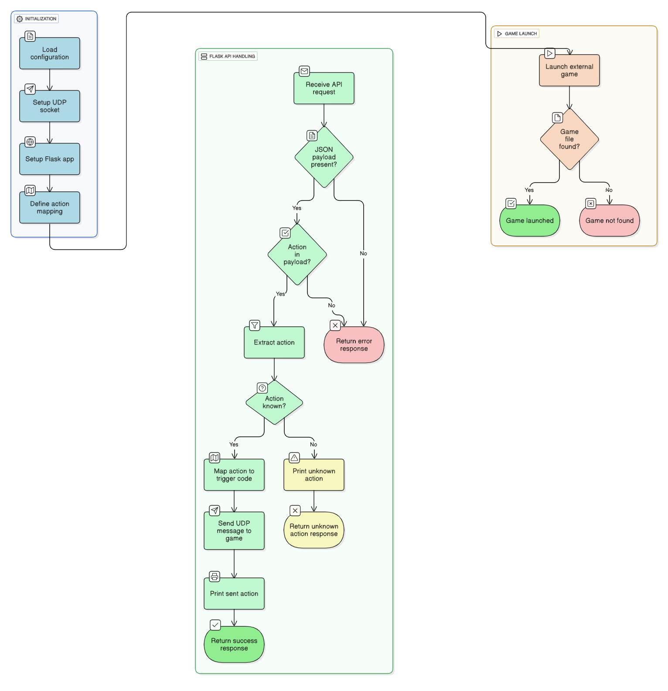
ONLINE COMMUNICATION

Slide 57
LIMITATIONS
EEG Signal Challenges: Residual noise, motion & muscle artifacts affect accuracy.
Performance Limits: Low selection speed (ITR), high user training needs, no long-term fatigue data.
Hardware & Data Constraints: Dependent on Unicorn Hybrid Black specs.
Small dataset limits advanced models (e.g., CNNs).
EEG Trade-offs: Chosen for being non-invasive, affordable & portable.
Lower spatial resolution & higher noise than ECoG/MEG.
BCI Illiteracy: Conduct repeated practice sessions before data collection to build system familiarity.

Slide 58
Conclusions
Summary
BCI system for users with severe motor disabilities.
Integrated into Educational apps & platforms Custom BCI games (UNO & Maze)
Tested with collected dataset; demonstrated real-world feasibility.
Developed an online and offline analysis system to predict user-commands.
Future Directions
Collect more data.
Adjust preprocessing stages according to data.
Use different classification techniques.
Enhance user experience with engaging, life-like interactions.

Slide 59
THANK YOU
ANY QUESTIONS

Slide 60

BUSINESS MODEL CANVAS

Slide 61

1 2 3
MAZE FLOWCHART
1 2 3

Slide 62


UNO FLOWCHART OFFLINE

Slide 63

UNO FLOWCHART ONLINE

Slide 64


UNO FLOWCHART ONLINE

Slide 65

UNO FLOWCHART ONLINE

Slide 66

EEG ANALYSIS
FLOWCHART

